Slide 1


SMART INDIA HACKATHON 2024
TITLE PAGE
Problem Statement ID – SIH1631
Problem Statement Title- AI-Powered Student Assistance Chatbot for Department of Technical Education, Government of Rajasthan.
Theme- Smart Education
PS Category- Software
Team ID- 7245
Team Name- INGLOURIOUS_BUGSTARS_061

Slide 2
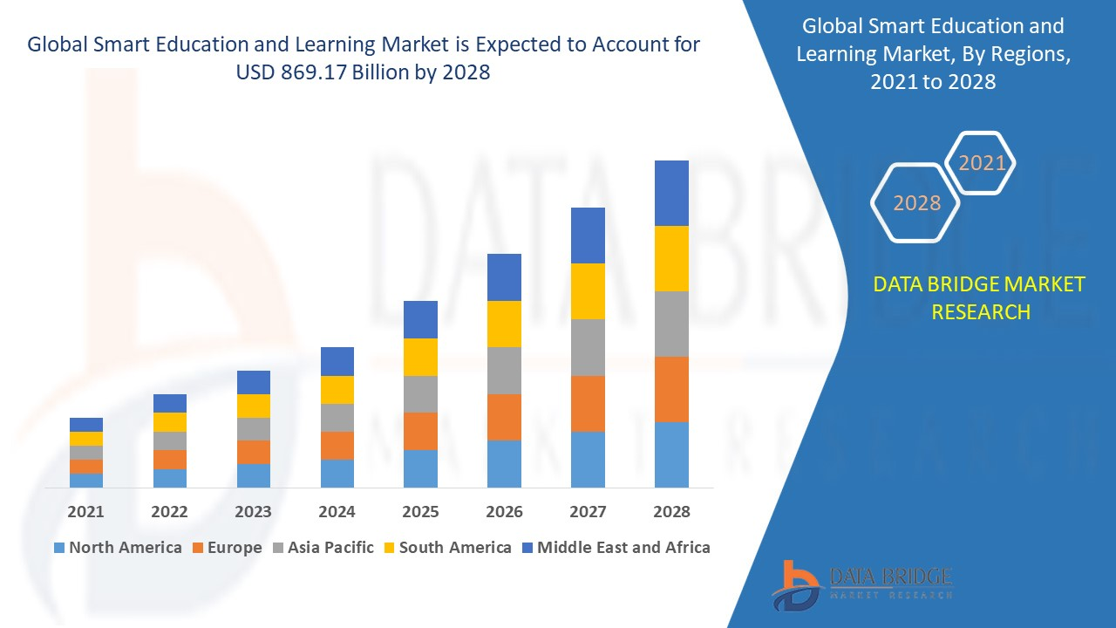
SMART EDUCATION AI-powered education simplifies access, empowers students, and enhances learning experiences.
INGLOURIOUS_BUGSTARS_061
Smart Learning Market
1
Solution Overview
2
Problem Solved
3
Key Innovations
24/7 Support: Instant answers on admissions, fees, and scholarships.
Natural Interaction: Users can chat with ease, like a real conversation.
Simple Interface: Easy, quick access to information.
Instant Help: Fast responses for common queries.
Reduced Workload: Automation frees staff from routine tasks.
Service Improvement: Continuous feedback for better services.
Interactive chat: Have engaging, real-time conversations.
Tailored Tips: Get suggestions made just for you.
Effortless Integration: Connect smoothly with what you already use.

Slide 3
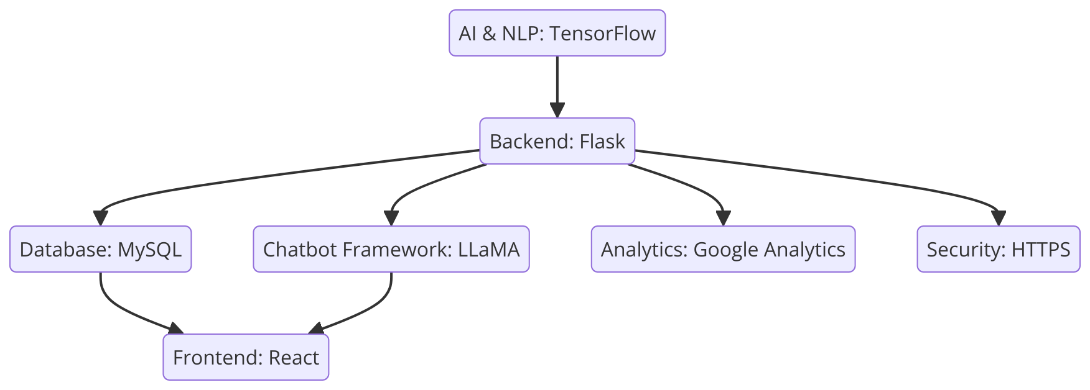
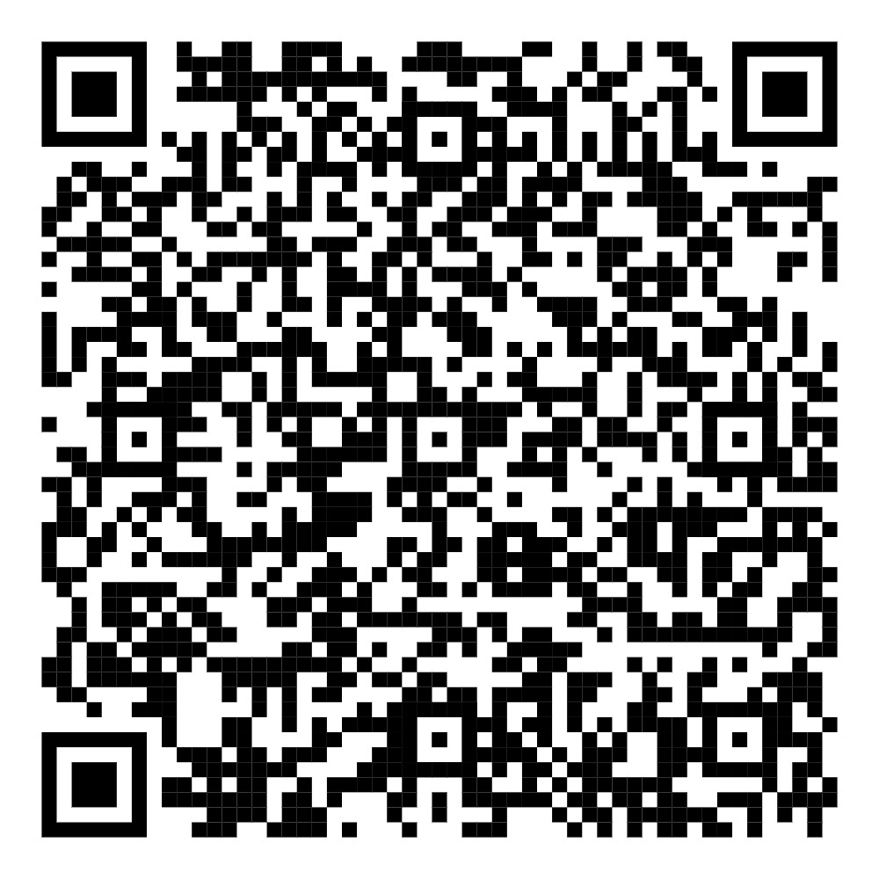
TECHNICAL APPROACH
INGLOURIOUS_ BUGSTARS_061
Scan to view the Documentation

Slide 4


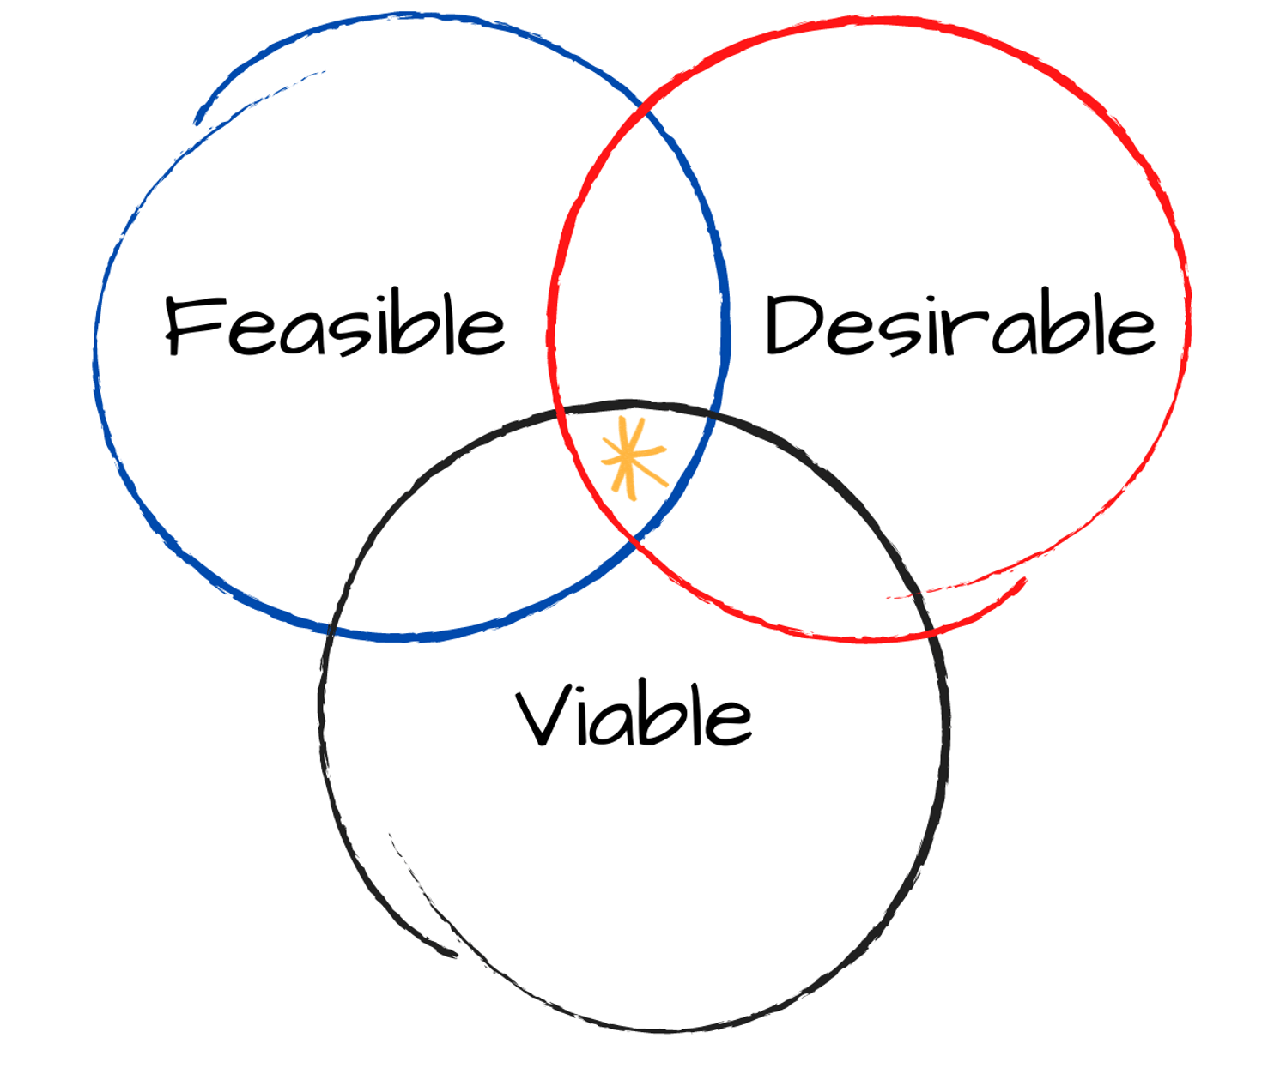
FEASIBILITY AND VIABILITY
INGLOURIOUS_ BUGSTARS_061
Feasibility
Smart Tech: Uses cutting-edge AI and adapts easily.
Easy Access: Works on all devices and can be personalized.
Challenges and Risks
Student Ease: Making sure students are comfortable using it.
Tech Issues: Handling occasional glitches and keeping things reliable.
Viability
Future-Ready: Adapts to changing needs and trends.
Engaging: Keeps students interested and improves with their feedback.
Scan to view the Documentation

Slide 5



IMPACT AND BENEFITS
INGLOURIOUS_ BUGSTARS_061
Solution Impacts
Personalized Help: Adapts to each student's needs.
Keeps Students Engaged: Provides timely support to keep them motivated.
Handles Growth: Manages increasing student queries smoothly.
Instant Feedback: Quickly addresses and improves student issues.
Benefits
Tailored Guidance: Offers custom support for each student.
Broad Reach: Assists students even in remote areas.
Easy Integration: Fits well with existing tools.
Supports Success: Helps students perform better academically.
Scan to view the Documentation

Slide 6




RESEARCH AND REFERENCES
INGLOURIOUS_ BUGSTARS_061
AI in Education: A Review
UNESCO - https://www.unesco.org/en/digital-education/artificial-intelligence
Creating Chatbots for Student Help
IEEE Xplore - https://ieeexplore.ieee.org/document/10053439
Case Study on AI Chatbots
ResearchGate - https://www.researchgate.net/publication/368942257_AI-Powered_Student_Assistance_Chatbot
Privacy in AI Systems
PubMed Central - https://www.ncbi.nlm.nih.gov/pmc/articles/PMC7631328/
How Chatbots are Changing Learning
YouTube - https://www.youtube.com/watch?v=-SbYjHoC-y8
Scan to view the Documentation

